Slide 1

OVERVIEW
Operating Systems
Chapter 1
Thái Hùng Văn
thvan@fit.hcmus.edu.vn

Slide 2
Objectives
In this chapter, you will:
Describe the general organization of a computer system and the role of interrupts
Describe the components in a modern, multiprocessor computer system
Illustrate the transition from user mode to kernel mode
Discuss how operating systems are used in various computing environments
Provide examples of free and open-source OSes
Notes:
Mô tả tổ chức chung của HTMT & vai trò của Ngắt
Mô tả các tp trong 1 HTMT đa CPU
Mhọa quá trình chuyển đổi từ chế độ người dùng sang chế độ kernel
Thảo luận cách sd HĐH trong các môi trường máy tính khác nhau
Cung cấp vd về các HĐH nguồn mở và miễn phí

Slide 3
Outline
Definitions & Basic Concepts
  What is OS ?
  Related Concepts
  More concepts (about OS)
  Computer system components
  Purpose of OSes
History of OSes
Computer-System Organization & Architecture
OS Operations
Resource Management
Security and Protection
Interrupts and system calls
Virtualization
Distributed Systems
Kernel Data Structures
Computing Environments
Free/Libre and Open-Source OSes

Slide 4
Definitions & Basic Concepts

Slide 5
What is OS ?
An OS (Operating System) is a X system that operates Y.
  X = ?
  Y = ?
  (X,Y) = (program, computer)
  // An OS is the program system that operates the computer.
What is Computer?
// device or machine processes data according to a set of instructions
What is Computer System (CS) ?
// consists of processor(s), main memory, storage, IO dev.
What is Computer Program ?
What is Computer Software ?
  * OS is a system software that operates both hardware and software of the computer system, it also manages all other application programs.
* OS goes hand in hand with Computer, OS is “the soul" of Computer !

Slide 6
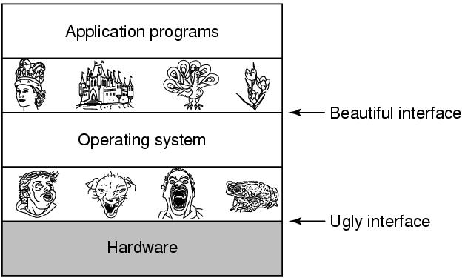
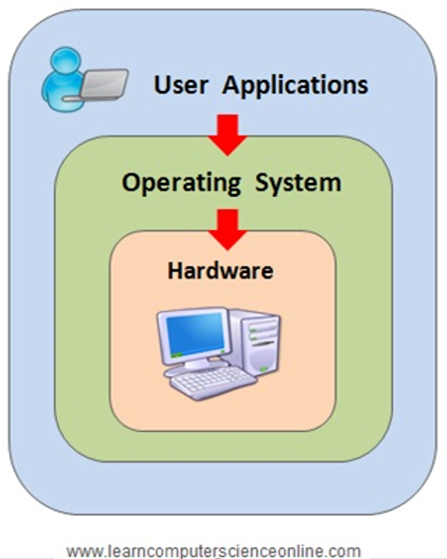
Related concepts
Software & Hardware
  In general
  In computer
Firmware
Humanware / Liveware
Program
  Source code file
  Object file
  Executable file
  Compiler & Linker
Programming & Programming Language
System software & Application software
Virtual Machine
  OS as an Extended Machine
Tanenbaum, Modern Operating Systems 3e, Prentice-Hall

Slide 7
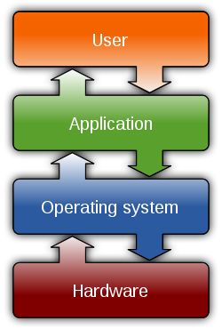
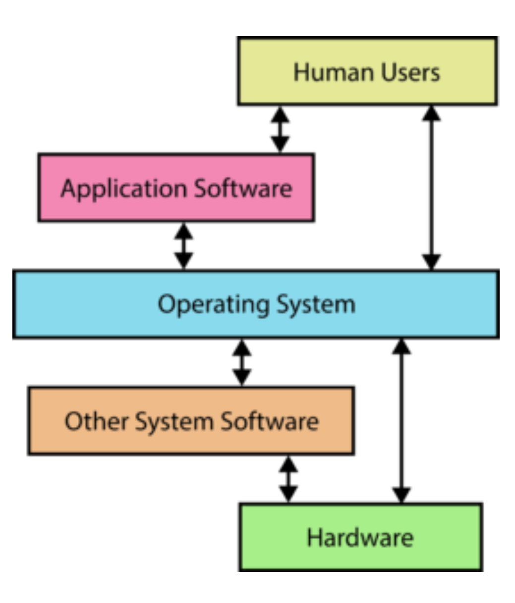
More concepts (about OS)
OS is the software that controls, manages and run all of the applications on the CS.
OS is defined as a collection of programs that coordinates the operations of computer hardware and software.
OS is a software performs all the basic tasks on CS, manages hardware and software resources and provides common services for other programs
OS supports the user's apps that can operate on the CS.
OS is an interface between user and computer hardware, enables the interaction of hardware and software.
OS is a resource allocator (Manages all resources for efficient and fair resource use) and a control program (Controls execution of programs to prevent errors and improper use of the CS)
OS is the heart of the CS
// OS stops functioning => Whole system will crash,
Without an OS, your machine can not function at all.
Notes:
OS là PM đ.khiển, qu.lý và chạy t.cả ƯD trên HTMT. / OS đc đn là tập hợp các CT đ.phối h.động của PC & PM MT. /
OS là PM th.hiện t.cả tác vụ cơ bản trên HTMT, qu.lý tài nguyên PC, PM và cung cấp các dịch vụ chung cho các CT khác.
OS hỗ trợ các ƯD của user có thể hoạt động trên MT. / OS là gi.diện giữa user & PC MT, cho phép tương tác giữa PC & PM.
OS là bộ cấp phát tài nguyên (Qu.lý t.cả TN để sd TN h.quả & công bằng) và là 1 CT đ.khiển (K.soát việc thực thi các CT để ngăn ngừa lỗi và sd MT ko đúng cách)
OS ngừng h.động => Toàn hệ thống sẽ bị lỗi, Không có OS, máy ko thể h.động.

Slide 8
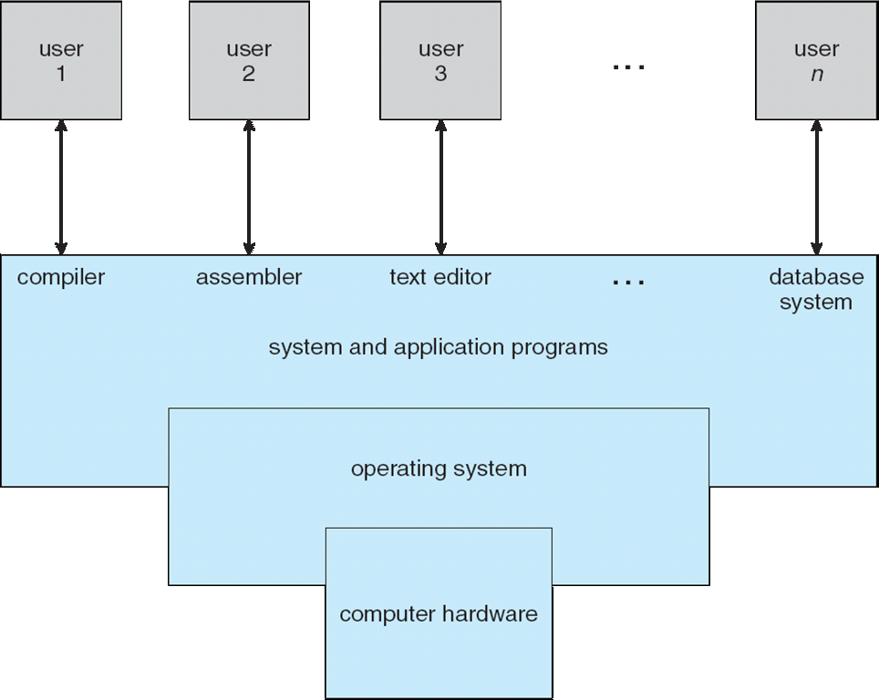
Computer system components
Hardware : provides basic computing resources (CPU, memory, I/O devices)
  OS : controls and coordinates use of hardware among various apps and users
  Application programs : define the ways in which the system resources are used to solve the computing problems of the users (word processors, compilers, web browsers, presentations, video players, games,...)
  Users : People, machines, other CSes

Slide 9
  Purpose of OSes
General-purpose :
  Manages CS resources and hosts applications that run on CS.
  Provides a platform on which a user can execute programs conveniently and efficiently. (The primary goal is to provide a user-friendly and convenient environment. The secondary goal is efficiency)
  Special-purpose: In order to achieve the above goals, OS performs functions:
  Process Management (Allocates system resources and manages running programs )
  Memory Management (Manages and optimizes the allocation of main memory to different processes)
  I/O Management (Controls and coordinates communication with peripheral devices)
  File Management (Organizes and controls the storage and retrieval of data on storage devices)
  User interface (Provides a means for users to interact with the CS)
Notes:
- Qu.lý các TN HTMT & giúp các ƯD chạy đc trên HTMT. // user thường làm việc qua các app, app lại nhờ OS
- Ccấp 1 nền tảng trên đó user có thể thực hiện các CT th.tiện & h.quả. (M.tiêu chính là ccấp 1 mtrường th.thiện & th.tiện cho user, mtiêu #2 mới là hquả)
// OS làm “mẹ” - làm việc l.tục, hỗ trợ /gi.sát /đ.khiển /c.cấp /ch.sẻ các thứ cần thiết cho đàn con (apps) h.động /ăn chơi tốt đẹp: chạy nền suốt trong quá trình h.động của máy, qu.lý & c.cấp /ph.phối các TN 1 cách phù hợp /tối ưu để các apps chạy ổn định.

Slide 10
History of OSes

Slide 11
Generations
(1940s – 1950s) Vacuum Tubes
(1950s– 1960s) Transistors and Batch Systems
(1960s – 1970s) ICs and Multiprogramming
(1970s – 1980s) Microprocessors, Personal Computers
(1980s – 2010s) VLSI Technology, GUI, Networking and Internet
(2010s - present) AI, Quantum Computing, IoT, Cloud Computing

Slide 12
Generation 1
Vacuum Tubes:
  Computers used vacuum tubes for circuitry and electronic components.
Examples:
  ENIAC, UNIVAC I, IBM 701.

Slide 13
Generation 2
Transistors:
  Replaced vacuum tubes, smaller and more reliable. Magnetic
  Core Memory: Improved storage capabilities.
Examples:
  IBM 1401, DEC PDP-1, IBM 7094

Slide 14
Generation 3
Integrated Circuits:
  Multiple transistors on a single chip, increased processing power.
  Operating Systems: Introduced for task management and resource allocation.
Examples:
  IBM System/360, DEC PDP-11, IBM 370/168

Slide 15
Generation 4
Microprocessors:
  Single chip with CPU, memory, and control units.
  Personal Computers (PCs): Affordable and accessible to individuals.
Examples:
  Apple II, IBM PC, Commodore 64

Slide 16
Generation 5
VLSI Technology
  Very Large Scale Integration, more components on a chip.
  Graphical User Interfaces (GUI): Enhanced user interaction and ease of use.
  Networking and the Internet: Global connectivity and communication
Examples:
  IBM AS/400, Cray-2 Supercomputer, modern PCs

Slide 17
Generation 6
VLSI Technology
  Artificial Intelligence: Integration of AI technologies into computer systems.
  Quantum Computing: Utilizing quantum phenomena for advanced computing.
  Internet of Things (IoT): Interconnected devices and systems.
  Cloud Computing: Accessing and storing data on remote servers. Advancements in nanotechnology, biotechnology, and more.

Slide 18
Types of OSes

Slide 19
OS Classification
Number of Tasks (Single-tasking OS and Multi-tasking OS)
Number of Programs (Single-programming OS and Multi-programming OS)
Number of Users (Single and multi-user / Stand alone and Network)
How OS handles (Batch, Time sharing, Multi-processing, Distributed, RTOS)
Purpose and Usage (General-purpose and Special-purpose OS)
Distribution and Licensing (Open-source and Proprietary OS)
Real-Time Requirements (Hard RTOS, Soft RTOS, Non RT OS)
User Interaction (Command-Line Interface (CLI) OS and Graphical User Interface (GUI) OS)
… …

Slide 20
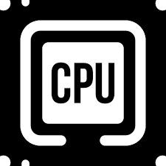
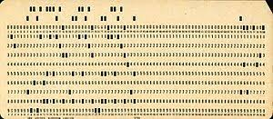
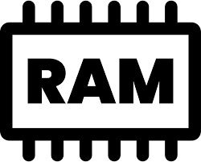
Batch OS
A job/program (i.e., set of instructions, data)
  Stored on punched cards, which are read by card readers
A batch (i.e., set of similar jobs)
  Executed one by one without user interaction directly
CPU is idle while the current job is waiting for I/O to complete
Lack of user interaction
Batch 1
Batch 2
Job1
Job3
Job2
Job4
Batch processing
Punched card

Slide 21
Multi-programming OS
Multiple programs are kept in memory simultaneously
While the current program is waiting for an I/O operation, the CPU switches to another
Maximize CPU utilization
CPU scheduling?
Memory protection?
OS
P1
Memory
partitions
P2
…

Slide 22
Multiprogramming OS
Batch system vs. Multiprogramming system
Batch
CPU
P1
Idle
P1
P2
Idle
P2
I/O
P1
P2
Multiprogramming
CPU
P1
P2
P1
P2
I/O
P1
P2

Slide 23
Time-sharing OS (Multi-tasking OS)
An extension of the multiprogramming system
Switches CPU among various programs
  Each program utilizes CPU
  in a short quantum of time (time slice)
  Requires direct interaction users/systems
Quick response to users
  Fast enough to give an illusion of pseudo-parallelism
More complex CPU scheduling
P1
P2
P3
...

Slide 24
Parallel OS (Multiprocessing OS)
Runs on multiprocessor computers with shared memory
Divides a program into multiple activities/jobs, which could be executed on different CPUs simultaneously to speed up the execution
Computing power increase
Reliability
Support of hardware and system architecture?
Parallel computing techniques?
P1
A
B
A
B

Slide 25
Real-time OS (RTOS)
Tasks must complete within time constraint
Hard real-time system: time constraint must be respected
  Time delay causes system failure (i.e., tasks MUST be done on time or fail)
  E.g., industrial control systems, traffic control system
Soft real-time system
  Time delay accepted occasionally
  E.g., multimedia system
Limited – Complex - Expensive

Slide 26
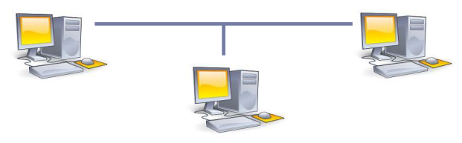
Distributed OS
Consists of independent systems linked via network
Need for a distributed OS
  Resource sharing
  Job collaboration
  Computing power increase

Slide 27
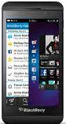
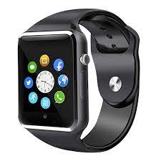
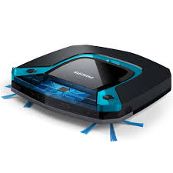
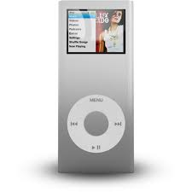
Embedded OS
Installed on phones, PDAs, and other devices (not a computer)
Designed for specific purpose
May or may not have user interface
☹ Limited resources (low CPU, small memory, no disk, ...)
☹ Complex algorithm
Smartphone
Smartwatch
Vacuum-cleaning robot
iPod

Slide 28
Main components

Slide 29
Process (and Thread) Management
Process and Thread operations (e.g., create, destroy)
  Process: a program in execution
  Thread: a lightweight process, supported in most modern OS
  Interprocess Communication (IPC)
  For exchanging data or collaborating to solve a task ...
  CPU Scheduling
  How to allocate CPU among many processes fairly and efficiently?
  Synchronization
  What if various processes access a common resource at the same time?

Slide 30
Memory Management
Main components
In a multiprogramming system, many programs to be executed (i.e., process) are resident in memory simultaneously.
OS deals with:
  Memory allocation, deallocation, and protection (against invalid access)
  Virtual memory management
    To have more space ...
    Programs loaded into memory partially ...

Slide 31
File Management
A file is an abstract concept provided by OS to store collection of data on disk
OS deals with:
  File organization
  File allocation/deallocation
  File storage on disk

Slide 32
I/O Management
OS acts as an intermediary between I/O request and physical devices (e.g., mouse, keyboard, screen, printer)
OS deals with:
  I/O hardware communication (e.g., device controller, DMA, polling, interrupt I/O)
  I/O software, which allows accessing and managing I/O operations (e.g., device driver, interrupt handler)

Slide 33
Structure

Slide 34
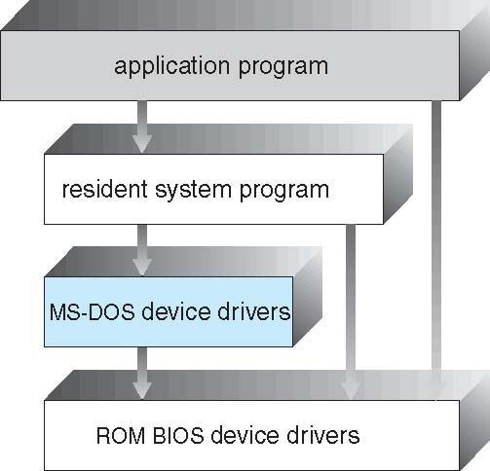
Simple structure
OS components are not well separated (e.g., MS-DOS)
  Application programs can access computer hardware directly
  Simple and easy to extend
  ☹ Vulnerable
  What if an application program fails?

Slide 35
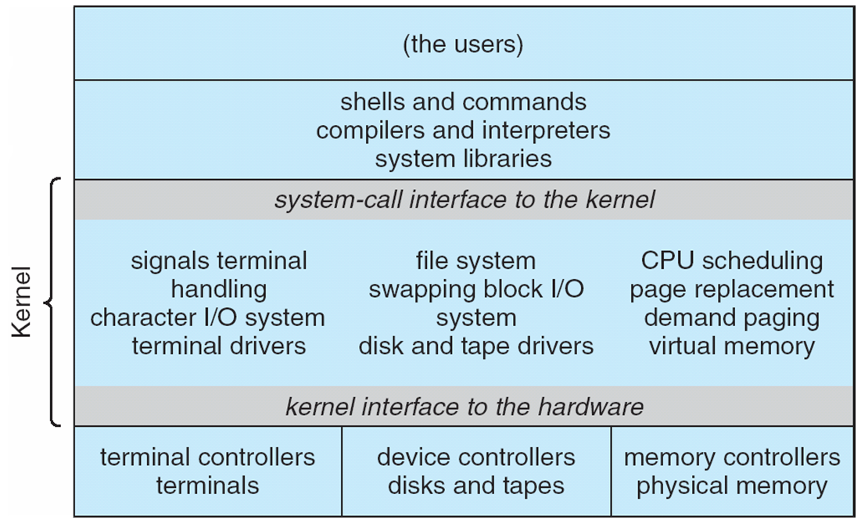
Monolithic structure
OS components are combined into one single module (e.g., traditional UNIX systems)
Each procedure (function) can call any other procedures
☺ Simple and fast
☹ Difficult to implement and maintain
User
Kernel

Slide 36
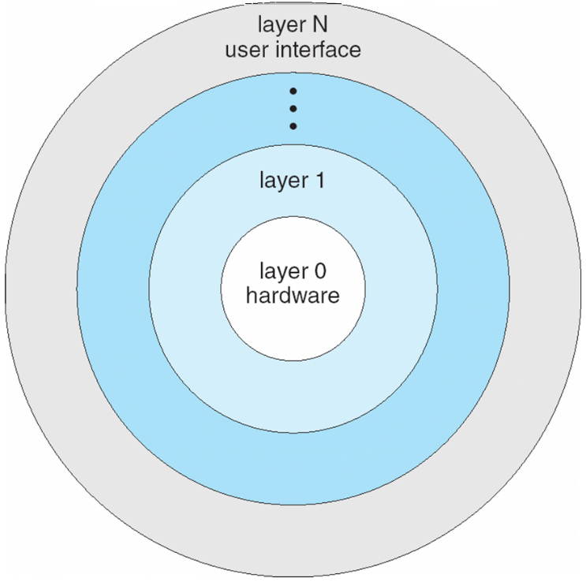
Layered structure
OS components are structured into layers (e.g., MULTICS)
Each layer uses services (operations, functions) prepared by its lower adjacent layer
  layer N calls services defined in layer N-1
☺ Easier to implement and maintain than monolithic structure
How to group services into layers? based on functionality?
When invoking a system call, a user program may need to pass through many layers
→ efficiency?

Slide 37
Microkernel structure
Kernel only stores essential components of OS (e.g., Mach)
Other components are implemented as user programs
Easy to manage, extend and build new architecture
Security and Reliability
☹ Performance problem occasionally
User
Kernel
Notes:
Easy to manage: smaller
Easy to extend:
when adding new services evolving user space, do not require kernel modification
When kernel need to be modified, the change tend to be fewer
Security: core compoenent protected from service
Reliability: less code run in kernel mode
Performance: message passing overhead

Slide 38
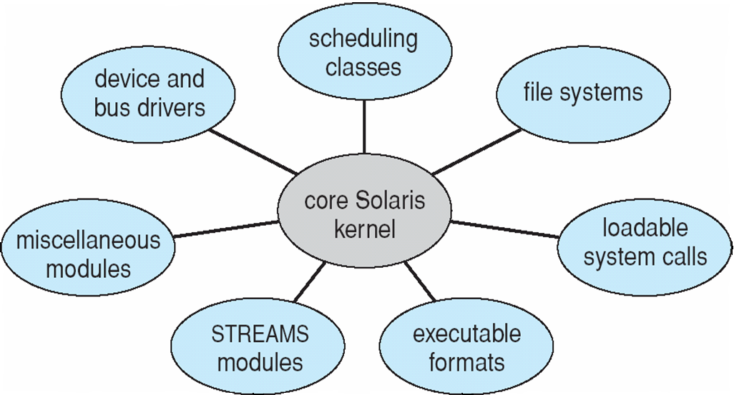
Module structure
A system consists of core kernel and additional services implemented as modules linked dynamically (e.g., Solaris)
☺ Easier to add new service than modify the kernel
☺ Security
☹ Not a clear design
Notes:
- Kernel is protected from service and application failures

Slide 39
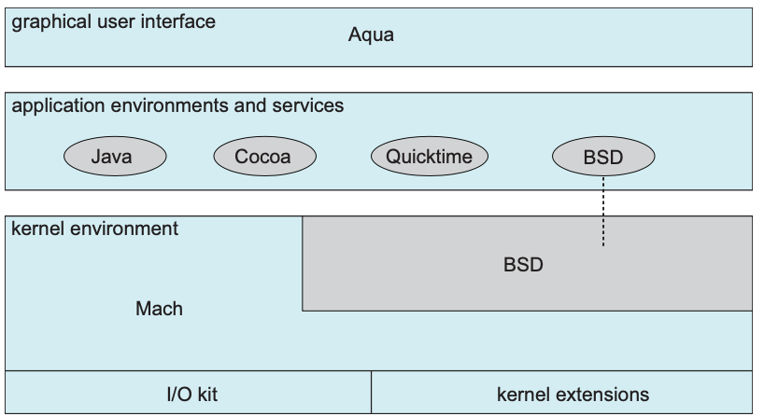
Hybrid structure
A combination of various structures to address performance, security and usability
Common design in many modern OS (e.g., Linux, Mac OS X, Windows, Android)
Hybrid system (Mac OS X)
Notes:
- Kernel is protected from service and application failures

Slide 40
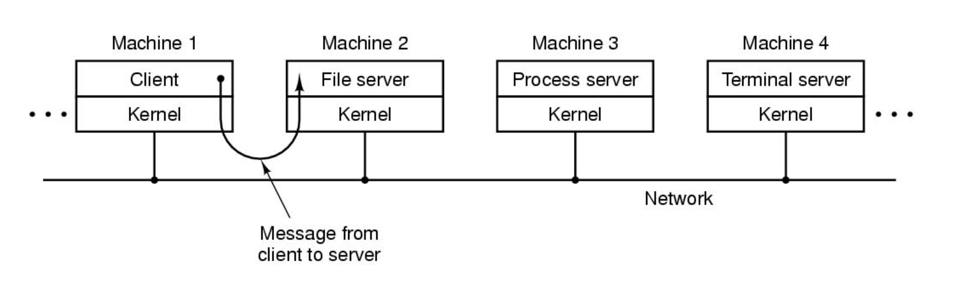
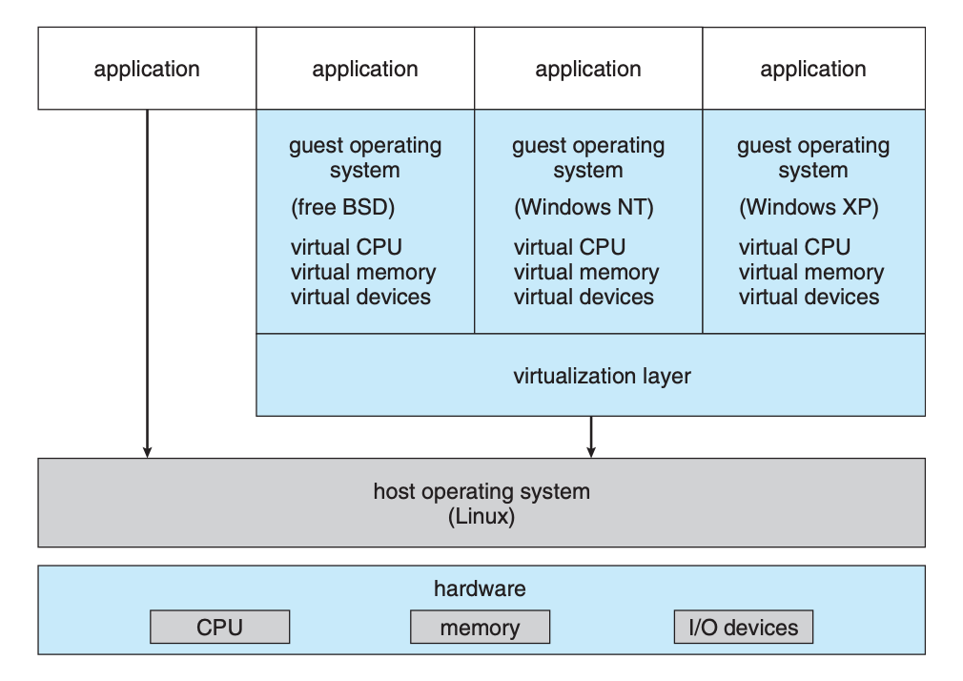
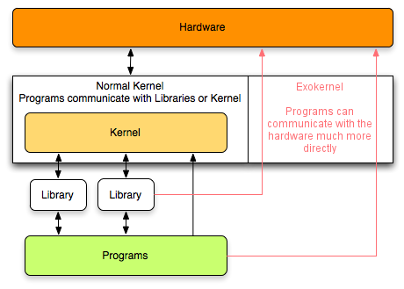
And other ...
Client-Server
Virtual machine
Exokernel

